Slide 1
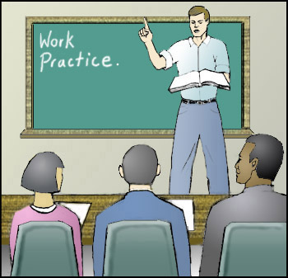

Careers Service
Jillian Gordon & Alan Cousins
Careers Advisers www.nidirect.gov.uk/careers
Careers Pathways – Non UCAS options
Notes:
Careers Service provides info, advice and guidance on career paths and plans. Reason we’re in to see you today is because you have a choice to make!

Slide 2
Careers Office details
Jillian Gordon
Alan Cousins
Newtownards Careers Office
9 Conway Square
Newtownards
BT23 4DA
Ballynahinch Careers Office
Crown Buildings
18 Crossgar Road
Ballynahinch
BT24 8XP

Slide 3
Aim of Today
Explore labour market information
Consider some options available at the end of year 14: - Further/Higher Education, Employment, Employment and Part-time study, setting up your own business, Apprenticeships, Gap Year
Maybe you are planning to go to university but want to look at the alternatives, or back up plans

Slide 4
Matching the skills of tomorrow to the youth of today
Future skills provision is complex - hard to predict!
Many skills are cross-sectoral (languages, business, sales and marketing, management & leadership)
Individual sectors have both generic and specific requirements (health sector needs more than just doctors)
The workforce of tomorrow will need to be adaptable and offer a diversity of skills
Young people need to make well informed career choices but personal interest and ability is still very important
Notes:
Statisticians work had to make predictions but it is not an exact science, it is often immediate market led. What is seen as a current gap in the market may only require a limited number of experts so may be short lived. Need to be multi taskers- good all rounders

Slide 5
Skills in demand in NI
Food technologist
Factory operative
Butcher
Health, safety and quality control
Creative and digital media
ICT
Agri food sector
Business and financial services
Software developer
Network manager
Data input
PC repair and maintenance
Game developer
Animator
Web designer
Film maker
Sound production
Payroll assistant
Accounting technician
Advertising
Marketing
Retail
Entrepreneurship
Future job opportunities
Health and life sciences
Advanced manufacturing and engineering
Allied Health Professions, e.g. Physiotherapy, Podiatrist
Nurse
Health care assistant
Lab technician
Gas fitter
Biomass engineer
Solar panel fitter
Recycling operative
Renewable energies and recycling
Machine operator
Welder
Engineer – all disciplines

Slide 6

Benefits of University
Needed for some jobs
Opportunity to follow a passion
Some employers look for a degree
Potential for better earning
Social life
Independence

Slide 7

But – it’s not for everyone
The academic approach to learning is not for everyone
The cost (note tuition fees vary depending on where you study)
Don’t want to move away
Can’t move away
1 in 4 students drop out

Slide 8
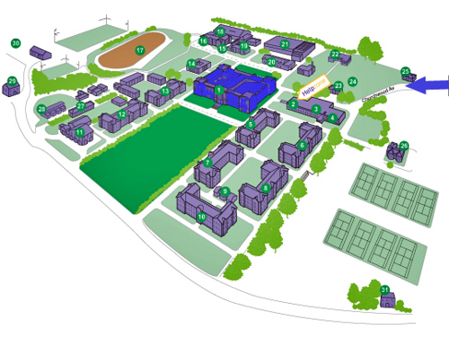
Further Education
belfastmet.ac.uk
  Titanic
  Millfield
serc.ac.uk
  Bangor
  Downpatrick
  Lisburn
  Newtownards
cafre.ac.uk
  Greenmount
  Loughry
  Enniskillen
src.ac.uk, nrc.ac.uk
swc.ac.uk, nwrc.ac.uk

Slide 9
Foundation Degree
Two years full-time
3 years part-time
Combines academic with work place learning
Designed in association with employers
Provides skills, knowledge & understanding
Increases professional and technical skills
Two thirds of a degree
Can top up to a full degree

Slide 10
BTEC Higher Nationals
HND mostly full-time over 2 years
HNC mostly part-time over 2 years
Recognised by employers around the world
Emphasis on developing practical skills
Strong focus on technical skills
Develops knowledge & understanding of industry
Assessed not exams
Can top up to a full degree (funding)

Slide 11
Remember....
Check if application procedure is via UCAS or direct to the FE college
Entry requirements vary depending on course/college – check carefully
This could be a useful back-up, as entry requirements may be lower than your degree choices
Flexible and close to home
Class sizes often smaller

Slide 12
Some courses....
Early Childhood studies
Hair and Beauty Management
Applied Biology
Applied Chemistry
Animal Management
Business
Accounting
Marketing
Fashion Management
Music
Performing Arts
Travel and Tourism management
Event Management
Graphic Design
Games Design
Software Engineering
Broadcast Journalism
Moving Image
Visual effects & animation
Web development technologies

Slide 13
And More Courses...
Electronic Engineering
Interactive Design
Mechanical Engineering
Architectural Technology with Sustainable Design
Building Services and Renewable Energies
Civil Engineering
Property, Planning and Housing
Sustainable Construction
Health and Social Care
Sports (Coaching and Development)
Sports (Exercise Science)

Slide 14
And More....
Advanced Practice in Work with Children and Families
Electronic and Electrical Engineering (Robotics)
Hospitality, Tourism and Events
Manufacturing Engineering
Mechatronic Engineering
Sport and Exercise Science
Health and Leisure Studies
Applied and Medical Science
Leadership and Management
Computing

Slide 15

Lots of Choice
Music Production
Photography
Sports Exercise and Fitness
Agriculture and Technology
Equine Management
Nutrition and Health
Food Manufacture
Horticulture

Slide 16

Some Validated By ...
Queens
University of Ulster
Stranmillis
St Mary’s
Can allow progression to Professional Associates/ Membership

Slide 17

Non UCAS options
Open University
cao.ie
eunicas.co.uk
studyabroad.com
Degreesahead.co.uk
Thestudentworld.com
fullbright.org.uk
Studyoptions.com

Slide 18
Part-time study
Balance work and other commitments
Study at a pace that suits you
Earn while you learn
Build up work experience, which sets you apart
Example
Ulster = £4995 at present for fee
Study over 6 yrs fees = £83.25 per month
Can be taught on campus, or on-line or a bit of both

Slide 19
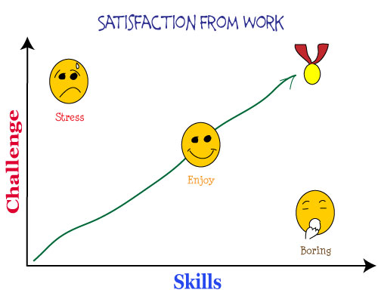
School Leaver Programmes
PWC
Deloitte
Santander
EY (Ernst & Young)
KPMG
Retail/ Hotel Companies

Slide 20

School Leaver Programmes
Career Conventions
Insight Days
Might be assessment tests
Grades 280 plus
A levels in one sitting
School facebook, noticeboards etc

Slide 21
Higher Apprenticeships
Finance Services
Life & Industrial Science
Engineering
Hospitality
IT/Computing
Creative industries....
Mix of Work and FE College
Study towards Foundation Degree quals or Equivalent L5
A levels grades vary, but 280 (PWC)
Caution though, changes coming down

Slide 22

Apprenticeships
Mix of work and college or Training Organisation
Peter Mark
Riverpark Training
Engineering Training council
Transport Training
Bombardier
BT Customer Services
NIE
Translink
Changes coming

Slide 23
Traineeship
Mix of college (T/0) and work experience
Training Allowance
Help with travel costs
16 - 24 year olds
As it stands at present
Again changes coming...
Example of occupational
areas.....
Catering-Construction
Hairdressing- Retail
Admin-Engineering
Plumbing-Horticulture
ETC

Slide 24

Year Out – Why?
You’re just not sure about University
You want/ need related work experience before your course
Do something you have always wanted to do
Build a CV
Consider longer term goals
Enrich your life

Slide 25

Year out – Why?
Exciting
Challenging
Valuable
Fun
Achievement
New environment
Deal with unexpected
At home
Or abroad

Slide 26

Year out – What ?
Improve on or learn new skills on a course
Live abroad on cultural exchange
Participate in a structured programme, e.g. gapyear.com
Volunteer
Tailor the year out to your goals!!

Slide 27
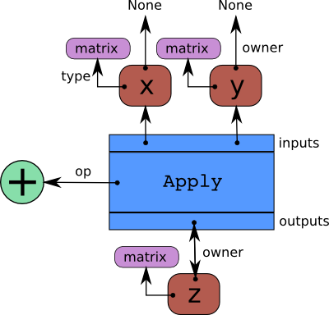
Year out – Great opportunities
But....
Check with university
Start research early
What do you want to achieve?
Contact organisations
Apply
Continue research

Slide 28

Further Education College
End Yr13 or Yr14
A Level - Fast track (BMC)
Vocational qualifications
Summer courses – e.g. Essential Skills
Research
Apply Jan/Feb

Slide 29
Employment
Administrative posts with health trusts, solicitors, doctors offices
Retail
Armed forces
Call centre
Hospitality
See www.nidirect.gov.uk – Looking for work

Slide 30

Job-searching...
Jobcentre online
Websites such as NIJobs
Newspapers
Develop your p/t job
Employment agencies
Networking
CV – Careers Service
MAPS – personal style report

Slide 31

For the Entrepreneur
Start your own business
Princes Trust
Enterprise programme

Slide 32

Support with:
Business Plan
Training
Funding
Networking

Slide 33

You need to be:
Aged 18 – 30
Living NI (or E/S/W)
Unemployed or
Working less than 16 hr
Have an idea
princes-trust.org.uk

Slide 34
Careers Service – how we can help...
One-to-one interviews
Help with creating a CV
Job applications
Interview techniques
Resources on Careers Service website
Digital hub – chat to a careers adviser online

Slide 35


Slide 36
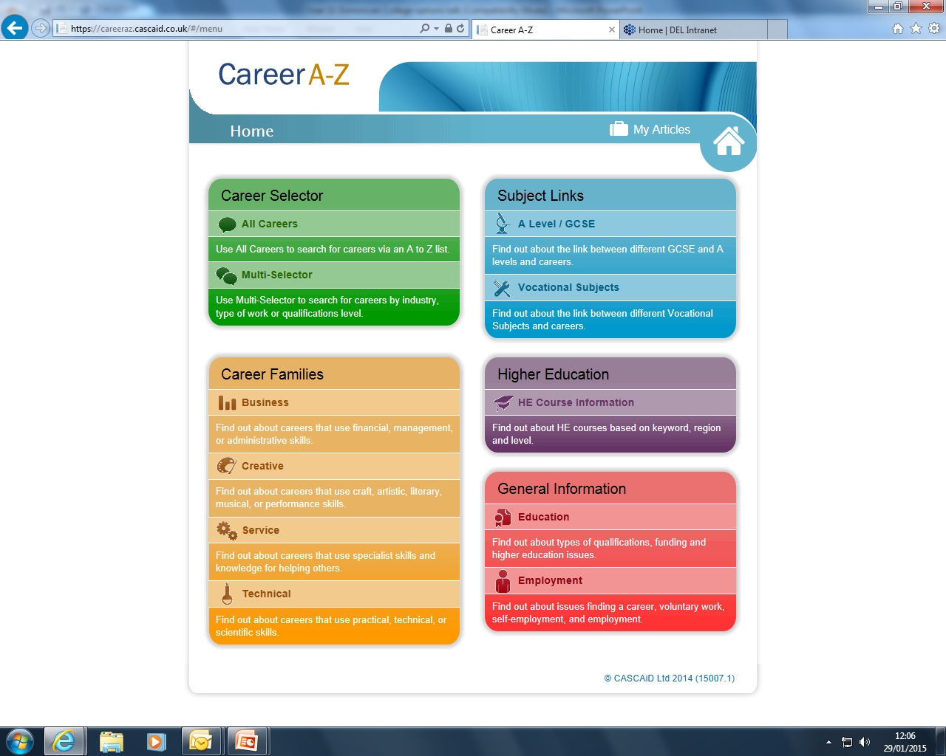

Slide 37
Useful websites for your research
www.notgoingtouni.co.uk
www.allaboutschoolleavers.co.uk
www.unisnotforme.com
www.ucas.com/undergraduate/getting-started/alternatives-higher-education
https://www.delni.gov.uk/publications/ni-skills-barometer

Slide 38

Summary
Foundation Degree
Higher National Diploma
O.U.
Study abroad
School Leavers programmes
Higher Apprenticeships
Training
Year out
Further Education
Jobs
Own Business

Slide 39

And finally......
Whatever route you are taking
Research
Research
Research
Have a good year

