Slide 1
Curriculum Vitae Year 13 General Studies PowerPoint 6

Slide 2
General rules –
Provide email address and phone number
Write a short profile – about yourself (personality, skills, interests and ambitions.
Qualification table
Work Experience
Extra-Curricular
Awards
Additional Information
2 referees – 1 academic
2 x A4 pages long

Slide 3
The following websites can be used to produce a professional CV – www.reed.co.uk/cvbuilder or GOOGLE ‘national careers service CV builder’ or
‘careers service NI CV builder’.
Or you can use the template provided.

Slide 4
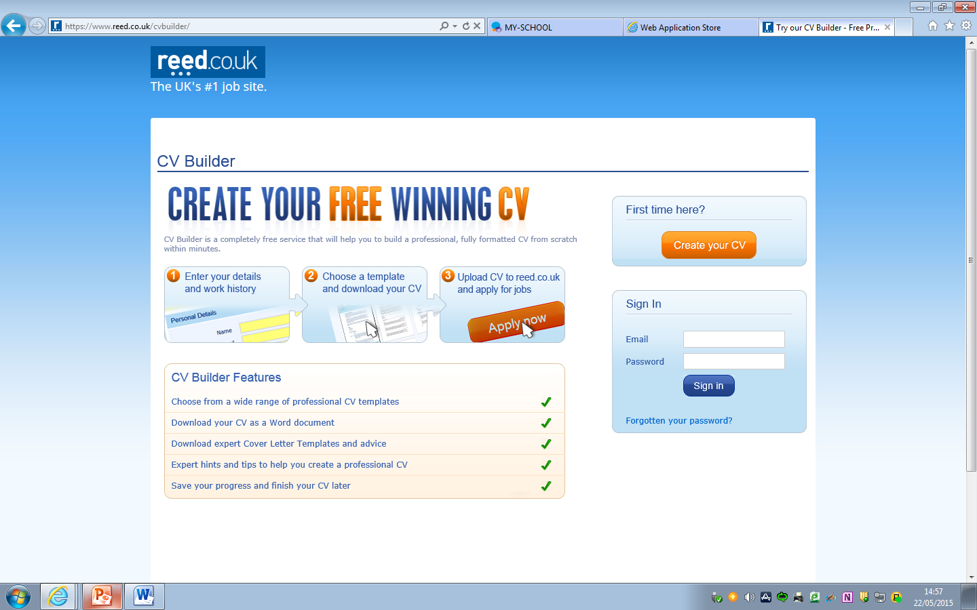
CV 1 - www.reed.co.uk/cvbuilder

Slide 5
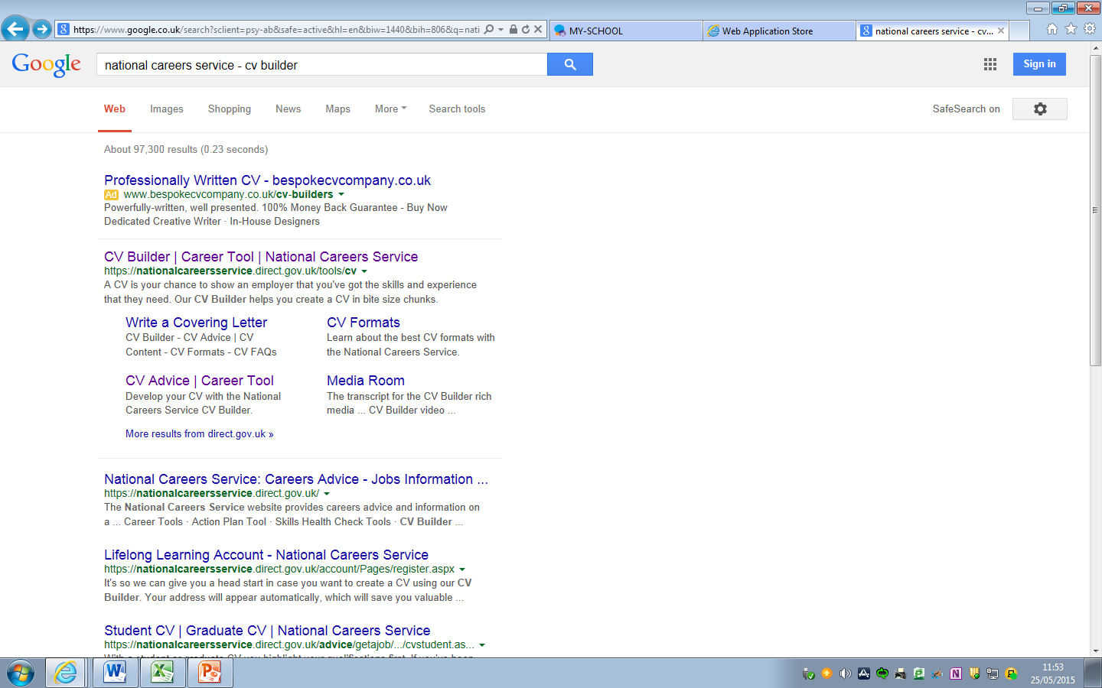
CV 2 -
Google ‘national careers service CV builder’

Slide 6
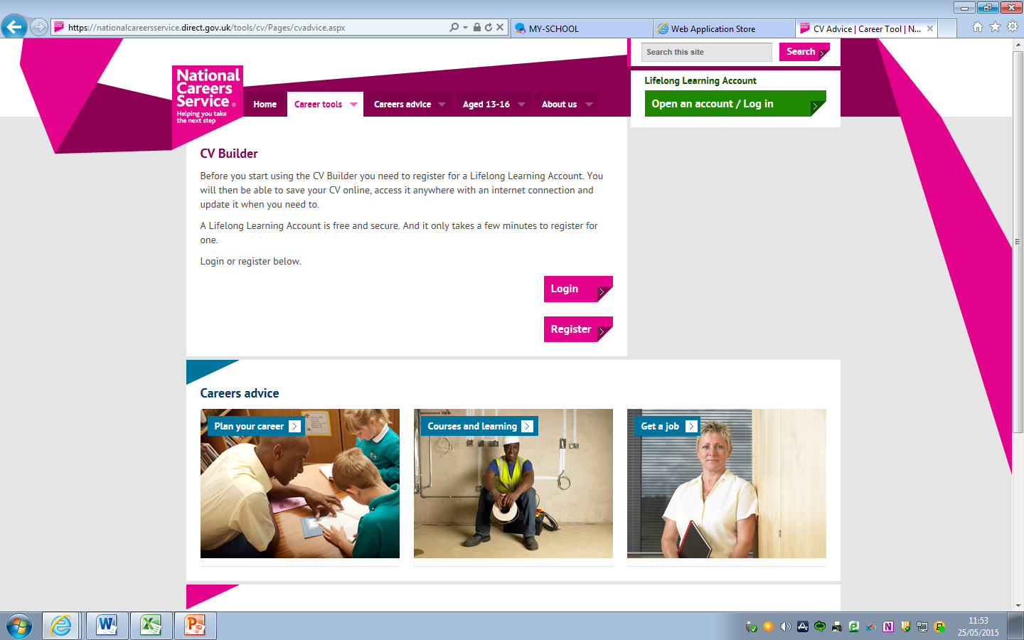

Slide 7
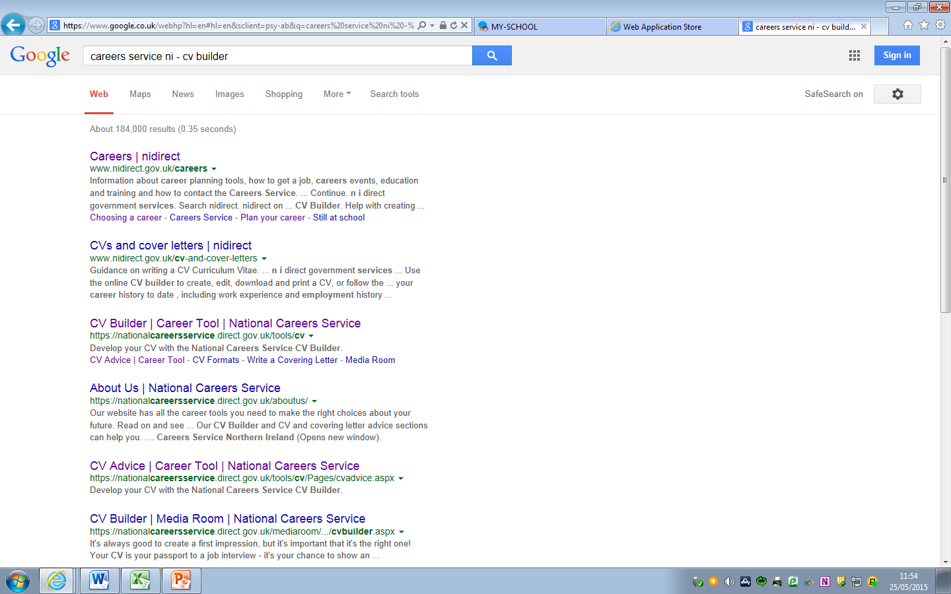
CV 3 -
Google ‘careers service ni CV builder’

Slide 8
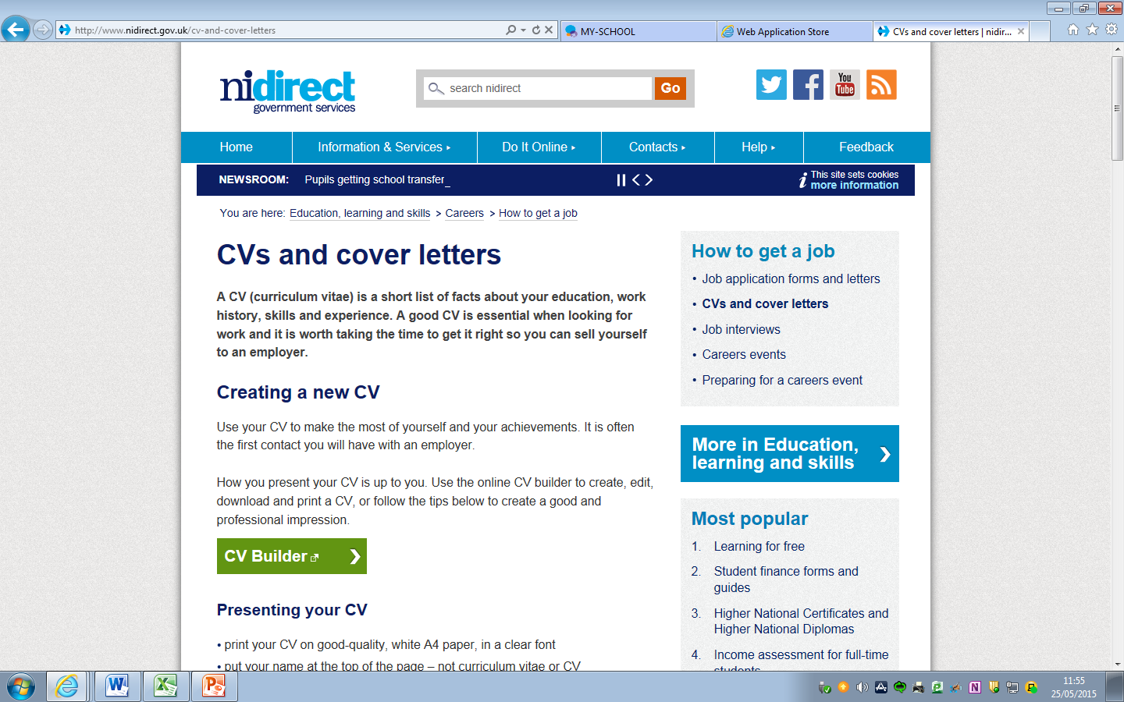

Slide 9
Jane Bloggs
123 Happy Close, Newtownards, Co Down, BT23 QWE.
Email - janebloggs@gmail.com Mobile – 0123456789
Profile: I am currently studying for 4 AS levels and plan to stay on at school to complete 3 A levels next year. I have a great interest in helping others and have volunteered at my local Gateway Club for 3 years. This experience has enabled me to develop my interpersonal, problem solving and communication skills. I am a very sociable person and enjoy participating in numerous extra-curricular activities including DOE and Guides. However, my focus remains on my studies and my ambition to pursue a successful career in international business.
Qualifications :
Regent House Grammar School (200? – present)
A Levels | Predicted Grades
Maths
Economics
French
AS Levels | Achieved Mock Grades | Predicted Grades
Maths
Economics
French
German

Slide 10
GCSEs | Mock Achieved Grades | Predicted Grades
Maths | A* | A
English Language | B | A
English Literature | B | B
Chemistry | A | A
French | C | B
Business Studies | A | B
History | C | C
PE | AA | AA
Drama | A | A*
Donaghadee Primary School (200? – 20??)
AQE Test Score | 112
Work History
Childminder (September 201? – present) – I regularly babysit for neighbours and enjoy helping a family with 3 active boys who love to play football. My patience, organisation and empathy skills are improving as a result of my time spent with them.
General Building Work (September 201? – present) - I have helped my father on housing and industrial building projects ever since I can remember; initially as a general labourer and now as a kitchen fitter.

Slide 11
Voluntary Work:
Regent House Student Council (September 201? – present) - I am one of a number of Year 13 students who meet regularly to represent each form class on a panel which discusses school policies, issues and improvements.
Ards Gateway Club (December 201? – present) – I have attended my local Gateway club for 3 years and enjoy interacting with all participants. My compassion, preparation and organisational skills have greatly improved.
Activities and Interests:
Football – train and play with local club – Ards Town - weekly. This evidences my reliability and team working skills.
Awards:
Duke of Edinburgh Bronze Award– I have just completed my Silver Award. My involvement shows my maturity, determination and leadership skills as well as my caring and dependable nature,
Referees:
Mrs A Teacher Mr Simon Scott
Head of History Ards Gateway Club
Regent House Grammar School 123 Prospect Pk
Circular Road Newtownards
Newtownards BT23 AGC
BT23 4QA Co. Down

Slide 12
Homework
Complete CV at home using any of the suggested resources.
Print and hand in a copy to GS Teacher next week.

